Slide 1
The Data Design Recipe
CS 5010 Program Design Paradigms “Bootcamp”
Lesson 1.3
© Mitchell Wand, 2012-2014
This work is licensed under a Creative Commons Attribution-NonCommercial 4.0 International License.

Slide 2
Learning Objectives for this Lesson
By the time you finish this lesson, you should be able to:
list the steps in the data design recipe
list the pieces of a data definition
explain what define-struct does
write a constructor template and interpretation for simple data

Slide 3
The Data Design Recipe
1. Information Analysis
2. Representation and Interpretation
3. Implementation
4. Constructor Template
5. Observer Template
6. Examples
7. Review
Notes:
Here is the data design recipe.

Slide 4
Brief Explanation of the Data Design Recipe
Information Analysis: What kind of information needs to be represented in your program? What kind of information is it?
Representation and Interpretation: how is the information represented as data? What is the meaning of each possible value of the data?
Implementation: definitions of needed structs.
Constructor template: tells how to construct a value of this type
Observer template: tells how to inspect a value of this type
Examples: samples to make clear to the reader what is intended
Review: How can your design be improved?

Slide 5
DDR Step 1. What information needs to be represented?
In general, you are representing information about one of many objects in the world
Your goal is represent enough information about that object to distinguish it from all the other similar objects
You may need to represent more information as well, depending on the application.

Slide 6
Example: representing a car
What cars are we trying to represent? How does one car in the set differ from the others? What information about that car do I need to know?
In a traffic simulation, I might only need to keep track of each car's position and velocity.
For TV coverage of an auto race, I might need to keep track of enough information to distinguish it from all the others in the race.
The car’s number would be enough, but I might want to display the name of the driver as well.
For an auto dealer, I might need to keep track of enough information to distinguish this car from all the others in the world.
The VIN (“Vehicle Identification Number”) would be enough, but I might want to have its model, color, etc. available for display.

Slide 7
Output of DDR Step 1
At the end of step 1, you should know what kind of data you need (scalar, compound, itemization, etc.)
Where you go from here depends on the kind of data.
In the lesson, we’ll see how to execute the Data Design Recipe for compound data.
Then we’ll go back and see how it works for the other kinds of data.

Slide 8
DDR Step 2. Representation and Interpetation
In Racket, we represent compound data as a struct
This is like a struct or record in other languages.
For the interpretation, we need to give an interpretation to each of the fields.

Slide 9
Example:
;; A Book in a bookstore
;; REPRESENTATION:
;; a Book is represented as a struct
;; (make-book author title on-hand price)
;; with the following fields:
;; author : String is the author's name
;; title : String is the title of the book
;; on-hand : NonNegInt is the number of copies
;; on hand
;; price : NonNegInt is the price of the book
;; in USD*100
;; (e.g. $7.95 => 795)

Slide 10
Another example: a Rocket
;; An Altitude is represented as a Real, measured in meters
;; A Velocity is represented as a Real, measured in meters/sec
;; upward
;; We have a single rocket, which is at some altitude and is
;; travelling vertically at some velocity.
;; REPRESENTATION:
;; A Rocket is represented as a struct
;; (make-rocket altitude velocity)
;; with the following fields:
;; altitude : Altitude is the rocket's altitude
;; velocity : Velocity is the rocket's velocity

Slide 11
DDR Step 3. Implementation
In Racket, we define new kinds of structs or records with define-struct.
We saw these in Lesson 0.4. Here’s a review:

Slide 12
Example of a structure definition in Racket
(define-struct book (author title on-hand price))
Executing this define-struct defines the following functions:
make-book
book-author
book-title
book-on-hand
book-price
book?
A constructor– GIVEN 4 arguments, RETURNS a book with the given fields
Selectors: GIVEN: a book, RETURNS: the value of the indicated field.
A Predicate: GIVEN: any value, RETURNS: true iff it is a book

Slide 13
DDR Step 4. Constructor Template
Tells how to construct a value of this type.
Example:
;; CONSTRUCTOR TEMPLATE FOR Book:
;; (make-book String String NonNegInt NonNegInt)
The kind of data in each field

Slide 14
Sometimes this format isn't enough
Example: a ring
This only makes sense if inner < outer .
inner
inner radius
We need to document this, so anybody who builds a ring will know that he or she has to satisfy this condition
outer radius
This condition is called a precondition or an invariant. Remember those words! Conditions like this will come up over and over again as we go along.

Slide 15
We document this in the representation
;; REPRESENTATION
;; A Ring is represented as a struct
;; (make-ring inner outer)
;; with the following fields:
;; inner : PosReal is the ring's inner radius
;; outer : PosReal is the ring's outer radius
;; WHERE (< inner outer) is true
;; IMPLEMENTATION
(define-struct ring (inner outer))
;; CONSTRUCTOR TEMPLATE:
;; (make-ring PosReal PosReal)

Slide 16
DDR Step 5: Observer Template
The observer template (or just the template, for short) gives a skeleton for functions that examine or use the data.
For compound data, this is easy:

Slide 17
Observer template for compound data
;; OBSERVER TEMPLATE
;; book-fn : Book -> ??
(define (book-fn b)
(...
(book-author b)
(book-title b)
(book-on-hand b)
(book-price b)))
This is an inventory of the quantities we can use to construct the answer.
We can fill in the ... with any expression, using any or all of the expressions in the inventory.

Slide 18
Putting it all together
;; A Book in a bookstore
;; REPRESENTATION:
;; a Book is represented as a struct (make-book author title on-hand price)
;; with the following fields:
;; author : String is the author's name
;; title : String is the title of the book
;; on-hand : NonNegInt is the number of copies on hand
;; price : NonNegInt is the price of the book in USD*100
;; (e.g. $7.95 => 795)
;; IMPLEMENTATION
(define-struct book (author title on-hand price))
;; CONSTRUCTOR TEMPLATE
;; (make-book String String NonNegInt NonNegInt)
;; OBSERVER TEMPLATE
;; book-fn : Book -> ??
(define (book-fn b)
(...
(book-author b)
(book-title b)
(book-on-hand b)
(book-price b)))

Slide 19
The DDR for scalar data
For scalar information, we need representation and interpretation
No need for implementation or constructor/observer templates

Slide 20
Examples of data definitions for scalar information
;; An Altitude is represented as a Real,
;; measured in meters
;; A Velocity is represented as a Real, measured in
;; meters/sec upward
;; A BookPrice is represented as a NonNegInt,
;; in USD*100 (e.g. $7.95 => 795)
;; A Vineyard is represented as a String
;; (any string will do)
;; A Vintage is represented as a PosInt in [1800,2100]
interpretation specifies units
interpretation specifies units and orientation
interpretation specifies units
When you say “String”, that always means that any string is a legal value!!
Any time your data definition says “String”, you should always write “Any string will do”.

Slide 21
The DDR for itemization data
;; A Size is represented as one of the following integers:
;; -- 8, 12, 16, 20, 30
;; INTERP: a cup size, in fluid ounces
;; NOTE: it would be wrong to say "the cup", since there is no cup
;; here. Look at the definition of CoffeeOrder below
;; NOTE: Constructor template is not necessary for itemization data
;; OBSERVER TEMPLATE:
;; size-fn : Size -> ?
(define (size-fn s)
(cond
[(= s 8) ...]
[(= s 12) ...]
[(= s 16) ...]
[(= s 20) ...]
[(= s 30) ...]))
The observer template consists of a cond with as many clauses as there are cases. The predicates in the cond select the relevant case.

Slide 22
Another example
Do we need an interpretation?
NO: common sense is good enough
A TLState is represented as one of the following strings:
-- "red"
-- "yellow"
-- "green"

Slide 23
Another example
Do we need an interpretation?
YES: the reader is unlikely to guess that 217 denotes green, 126 denotes yellow, and 43 denotes red.
A TLState is represented one of the following integers:
-- 217
-- 126
-- 43

Slide 24
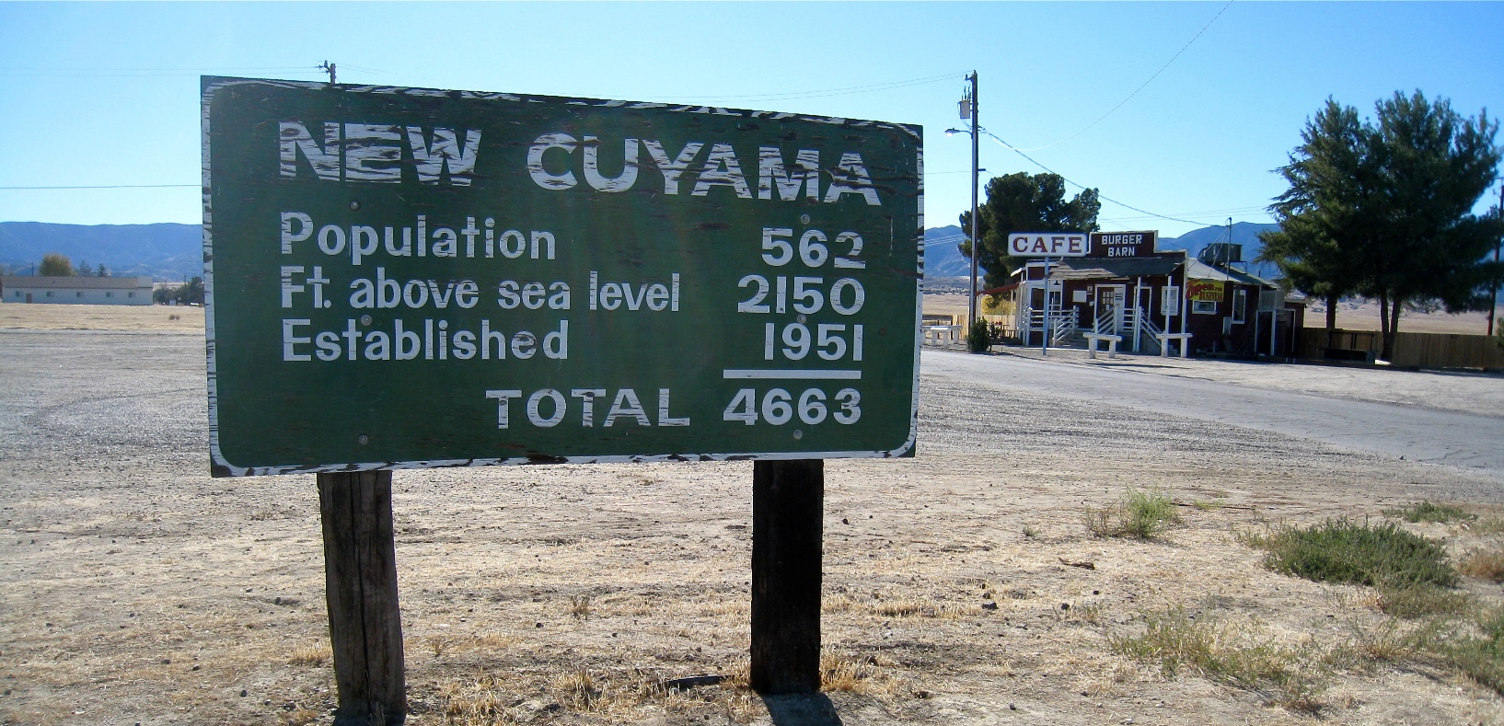
Remember: Not all integers are created equal
https://www.flickr.com/photos/7-how-7/4139229048/in/pool-1996770@N25/ licensed under
Creative Commons License
The interpretation tells you the meaning of each number. It also tells you
that you shouldn't be adding these integers!

Slide 25
The DDR for more complicated data
For example:
compound data where one or more fields are themselves compound or itemization data
itemization data where one of more fields are themselves compound or itemization data
We build the data definition for this more complicated data out of the definitions of the pieces.
This is less scary than it sounds.
Let’s do some examples

Slide 26
Case Study: BarOrder
In a wine bar, an order may be one of three things: a cup of coffee, a glass of wine, or a cup of tea.
For the coffee, we need to specify the size (small, medium, or large) and type (this is a fancy bar, so it carries many types of coffee). Also whether or not it should be served with milk.
For the wine, we need to specify which vineyard and which year.
For tea, we need the size of the cup and the type of tea (this is a fancy bar, so it carries many types of tea).

Slide 27
Case Study (part 2): CoffeeType
;; Preliminaries:
;; A Size is represented as ...
;; A CoffeeType is represented as a string
;; (any string will do)
Any time you write String, you MUST write "any string will do".
In a more detailed representation, we might specify CoffeeType further.

Slide 28
Case Study (part 3): CoffeeOrder
;; Definition of CoffeeOrder:
;; REPRESENTATION:
;; A CoffeeOrder is represented as a struct
;; (make-coffee-order size type milk)
;; with the following fields:
;; INTERP:
;; size : Size is the size of cup desired
;; type : CoffeeType is the kind of coffee order
;; milk : MilkType is the kind of milk ordered
;; IMPLEMENTATION:
(define-struct coffee-order (size type milk))
;; CONSTRUCTOR TEMPLATE
;; (make-coffee-order Size CoffeeType MilkType)
;; OBSERVER TEMPLATE
;; coffee-order-fn : CoffeeOrder -> ??
(define (coffee-order-fn co)
(...
(coffee-order-size co)
(coffee-order-type co)
(coffee-order-milk co)))

Slide 29
Case Study, completed: BarOrder
;; A WineOrder is represented as a ...
;; A TeaOrder is represented as a ...
;; A BarOrder is represented as one of
;; -- a CoffeeOrder
;; -- a WineOrder
;; -- a TeaOrder
;; CONSTRUCTOR TEMPLATE:
;; use the constructor templates for CoffeeOrder, WineOrder, or TeaOrder.
;; OBSERVER TEMPLATE:
;; bo-fn : BarOrder -> ??
;; STRATEGY: Cases on order : BarOrder
(define (bo-fn order)
(cond
[(coffee-order? order) ...]
[(wine-order? order) ...]
[(tea-order? order) ...]))

Slide 30
Using the BarOrder Observer Template
;; In the ... you can put a function on the order, or you
;; can expand the observer template for the compound
;; data, eg:
(define (my-bo-fn order)
(cond
[(coffee-order? order) (some-function
(coffee-order-size order)
(coffee-order-type order)
(coffee-order-milk order))]
[(wine-order? order) (some-other-function order)]
[(tea-order? order) (yet-another-function order)]))
Best practice is to expand all of them, as we’ve done here for the coffee-order alternative.

Slide 31
The Shape of the Program Follows the Shape of the Data
A BarOrder is one of
a CoffeeOrder
a WineOrder, or
a TeaOrder
The observer template tells that a function on BarOrders may call
a function on CoffeeOrders
a function on WineOrders, or
a function on TeaOrders

Slide 32
The Shape of the Program Follows the Shape of the Data
BarOrder
CoffeeOrder
TeaOrder
WineOrder
BarOrder function
CoffeeOrder function
WineOrder function
TeaOrder function
Data Hierarchy (the open triangle means “OR”)
Call Tree (the arrow goes from caller to callee)
We’ll see this principle over and over again!

Slide 33
DDR Step 7: Review
Nothing is done until you review it!
Before you move on, look at your data definition and ask the following questions

Slide 34
Reviewing a Data Design
Reviewing a Data Design
1. Is the interpretation clear and unambiguous?
2. Can you represent all the information you need for your program?
3. Do you need all of the data in your representation?
4. Does every combination of values make sense? If not, document the meaningful combinations with a WHERE clause.

Slide 35
Next Steps
If you have questions about this lesson, ask them on the Discussion Board
Go on to the next lesson

